Slide 1
TxCRCP-ME Interface Review

Slide 2
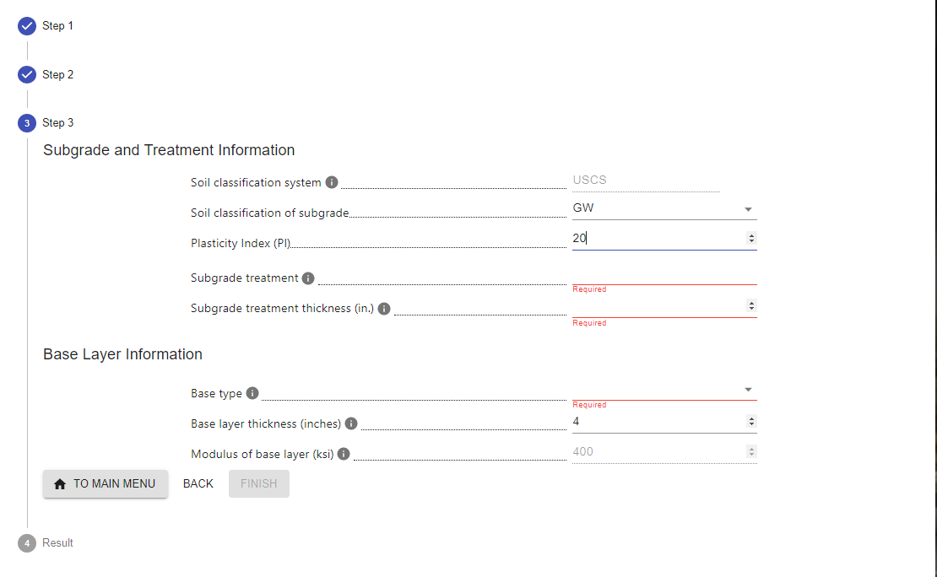
Suddenly popped up

Slide 3
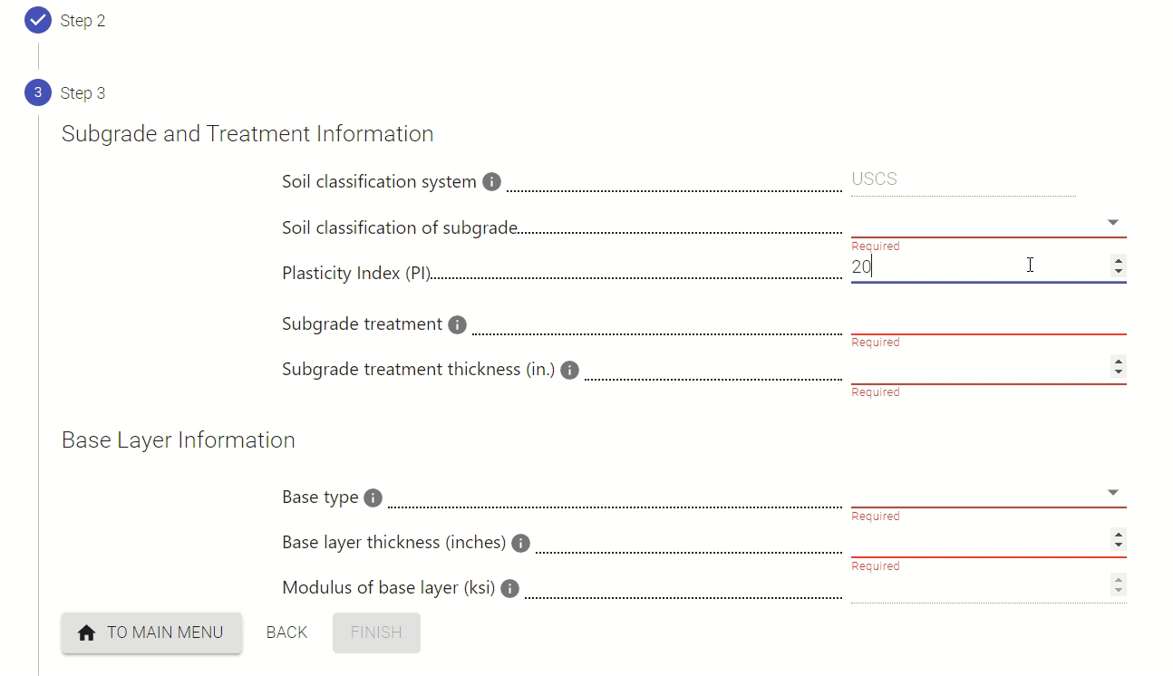
Fixed: not fill Base layer thickness until choose Base type

Slide 4
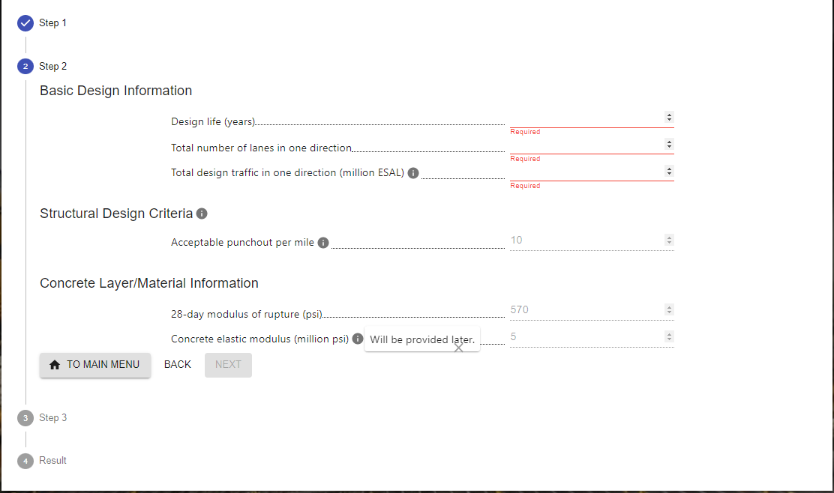

Slide 5
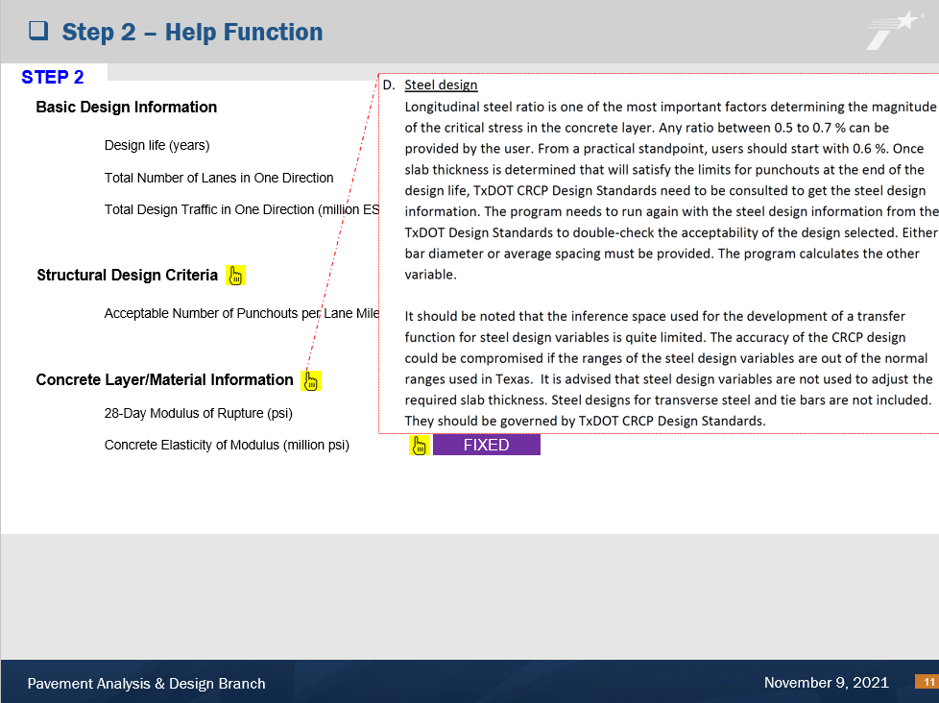
Pending: need information to fill in the pop up
Previous request not include information of pop up

Slide 6
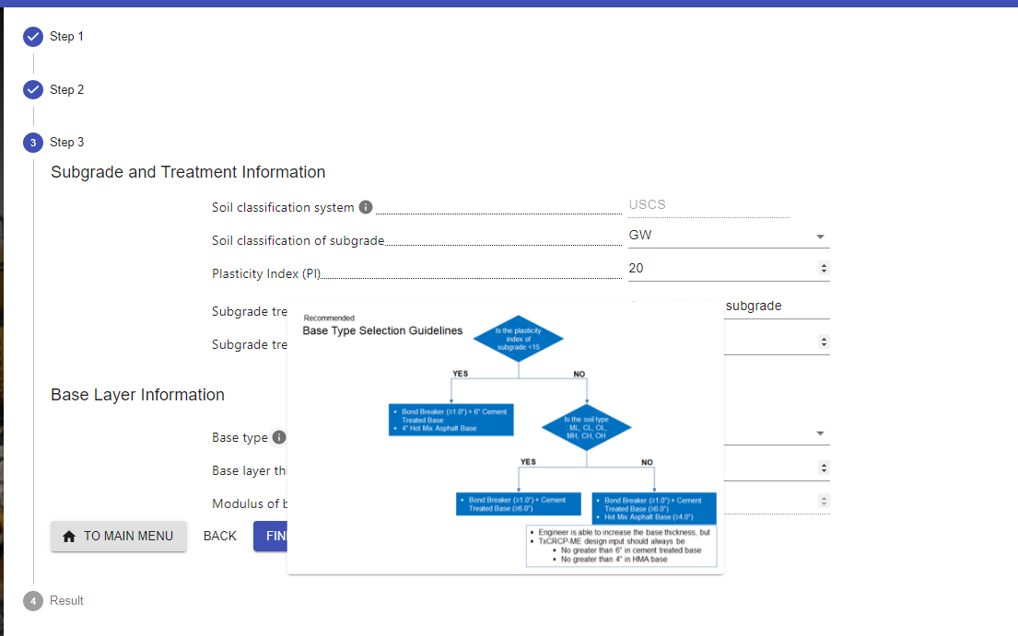
Should be Popped Up and Stay (high resolution)

Slide 7
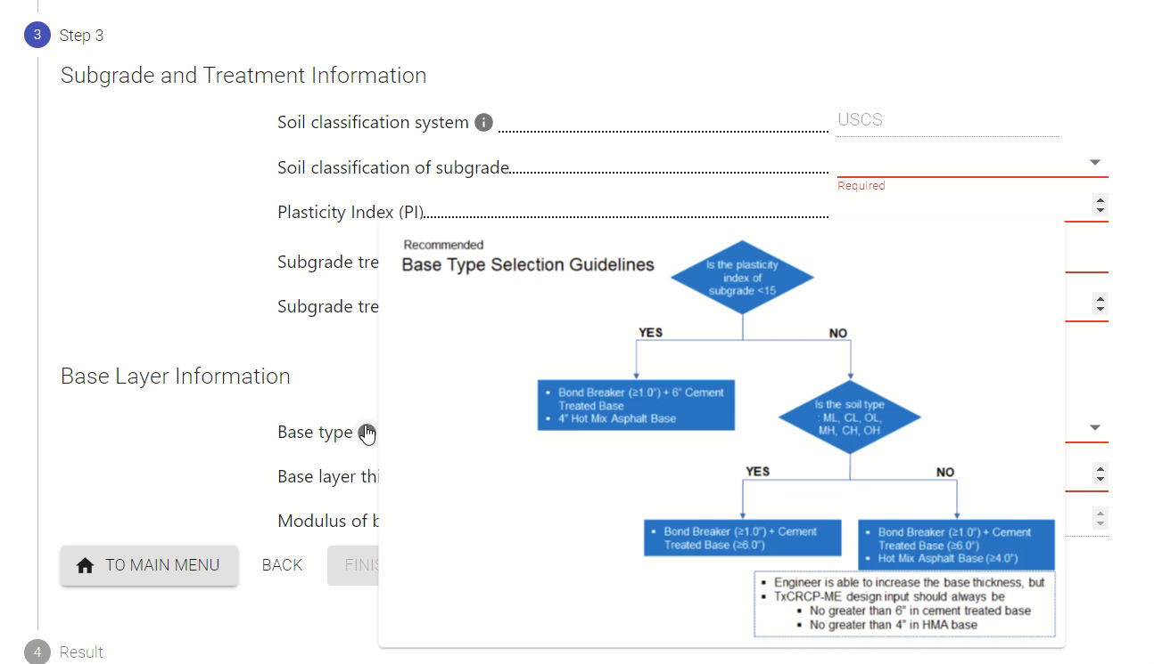
Fixed: click to keep the popup stay, using higher resolution

Slide 8
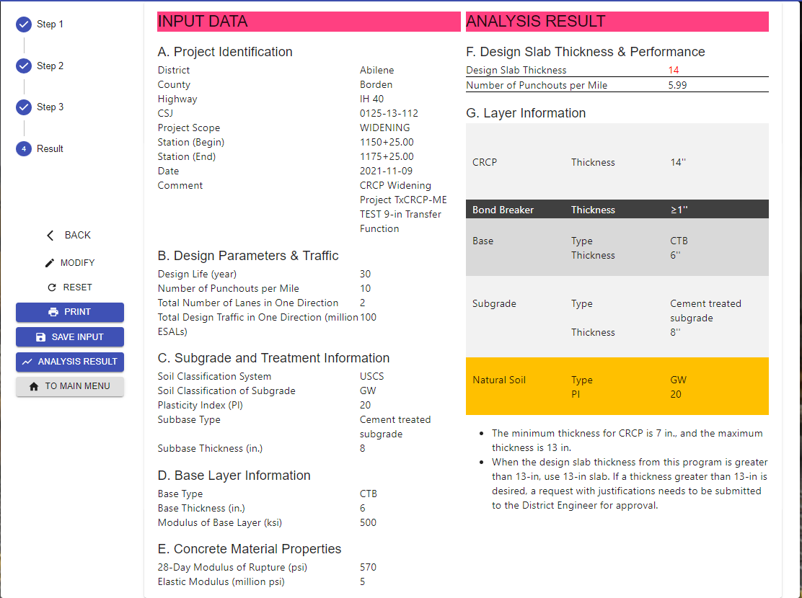
Total Design Traffic in One Direction 100
(million ESALs)
Subbase → Subgrade

Slide 9
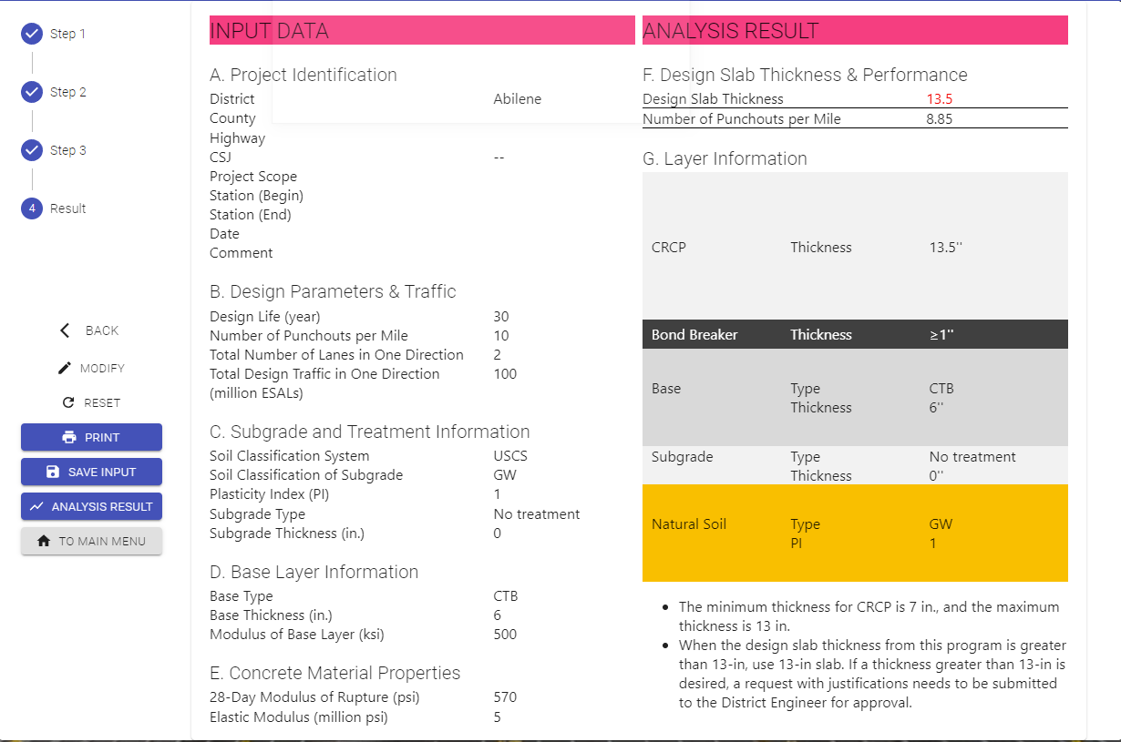
Fixed

Slide 10
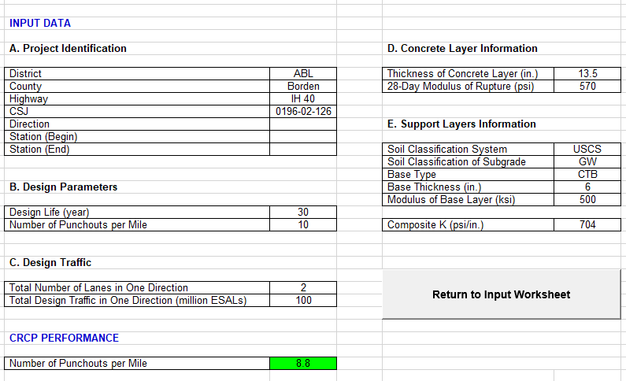
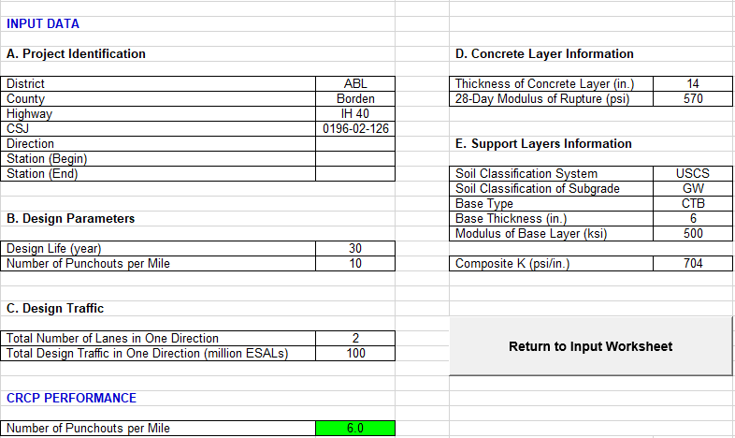
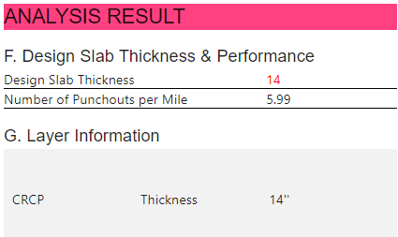
Major Issue – Design Thickness Increment should be a 0.5-in.

Slide 11
Fixed: Design Thickness Increment should be a 0.5-in.

